Slide 1
ECE 313: PROBABILITY WITH ENGINEERING APPLICATIONS
Fall 2023
Prof. Eric Chitambar
Lecture 6

Slide 2
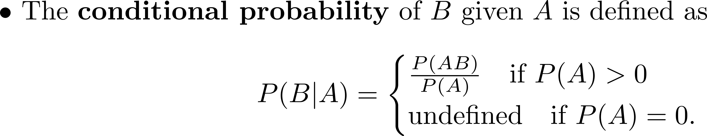



Conditional Probability

Slide 3

Conditional Probability

Slide 4
Example Problem

Slide 5
Conditional Probability and Independent Events

Slide 6
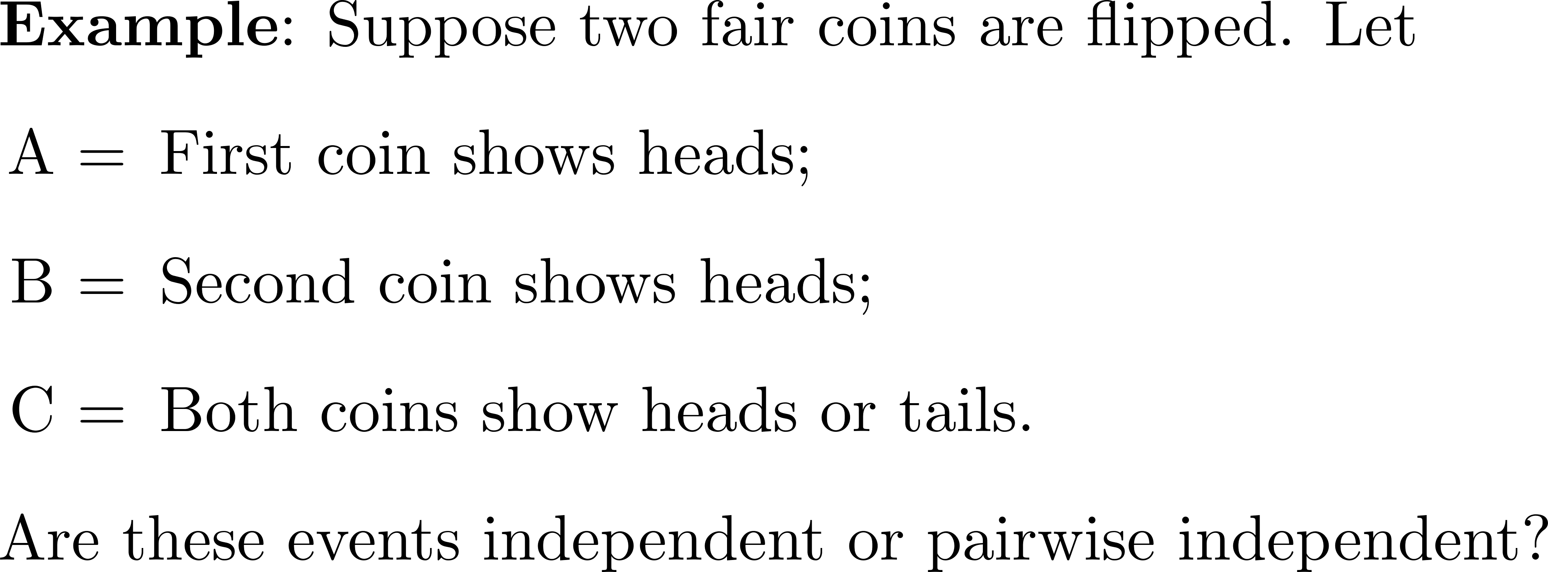
Conditional Probability and Independent Events

Slide 7
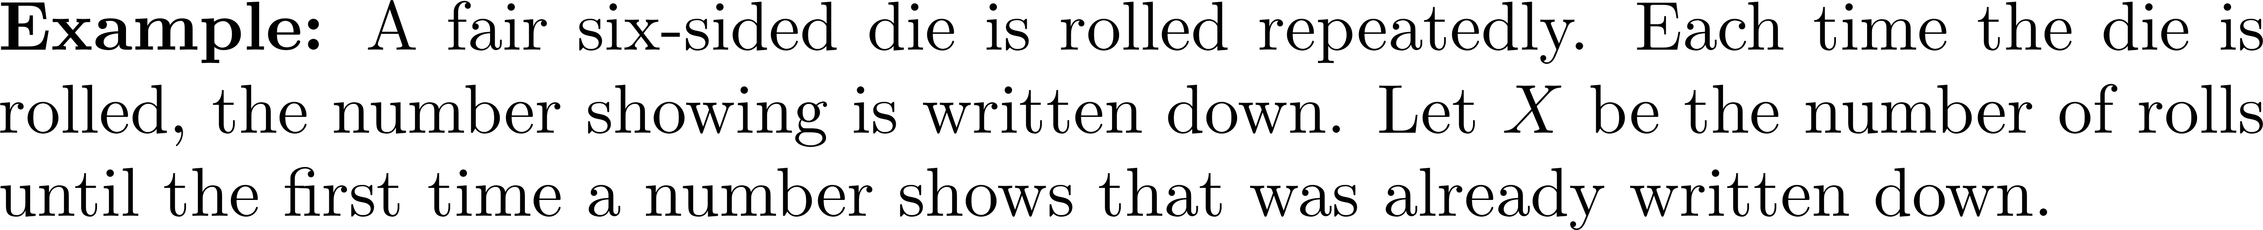
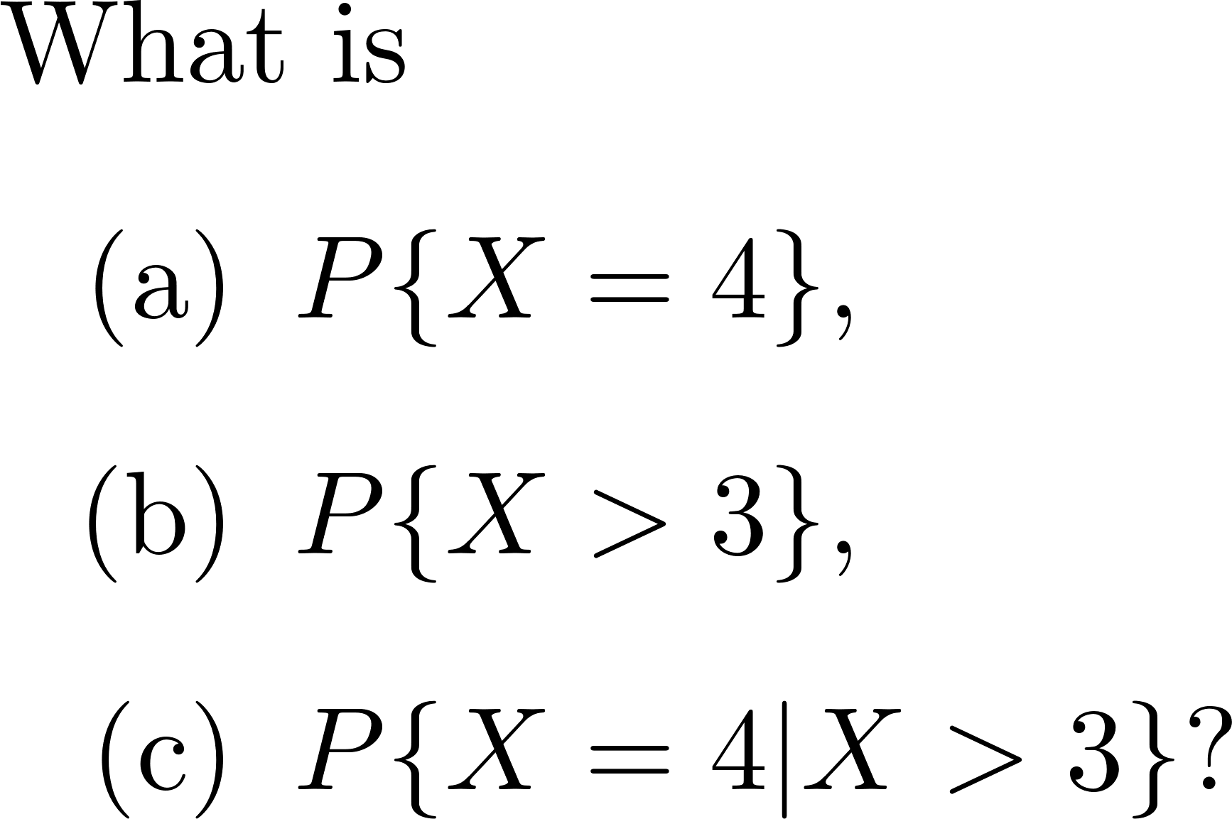
Independent Random Variables

